Slide 1
Climate-smart agriculture https://www.shui-eu.org
Climate Agriculture
Water Saving Agriculture
Soil Organic Carbon

Slide 2
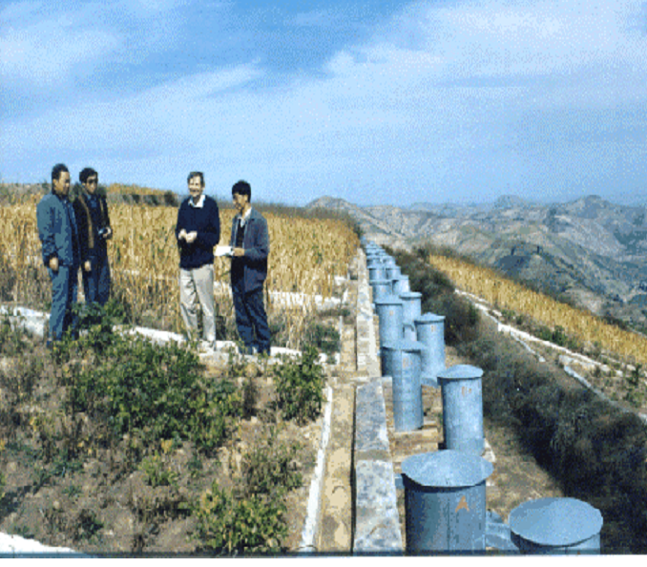
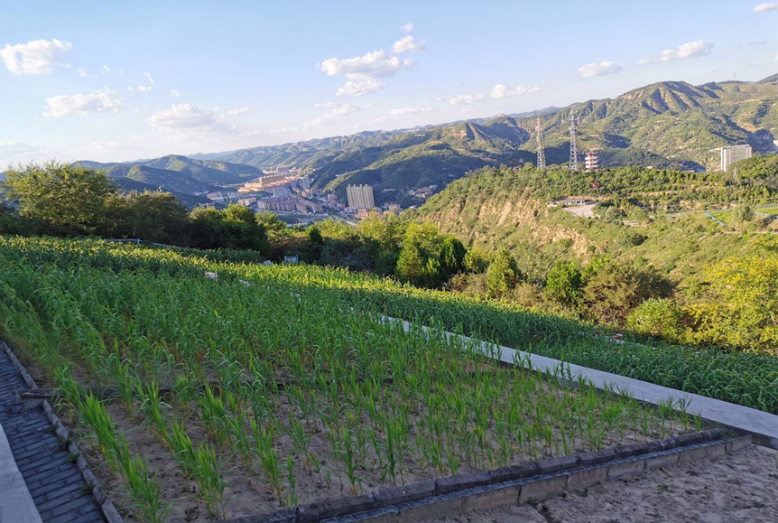
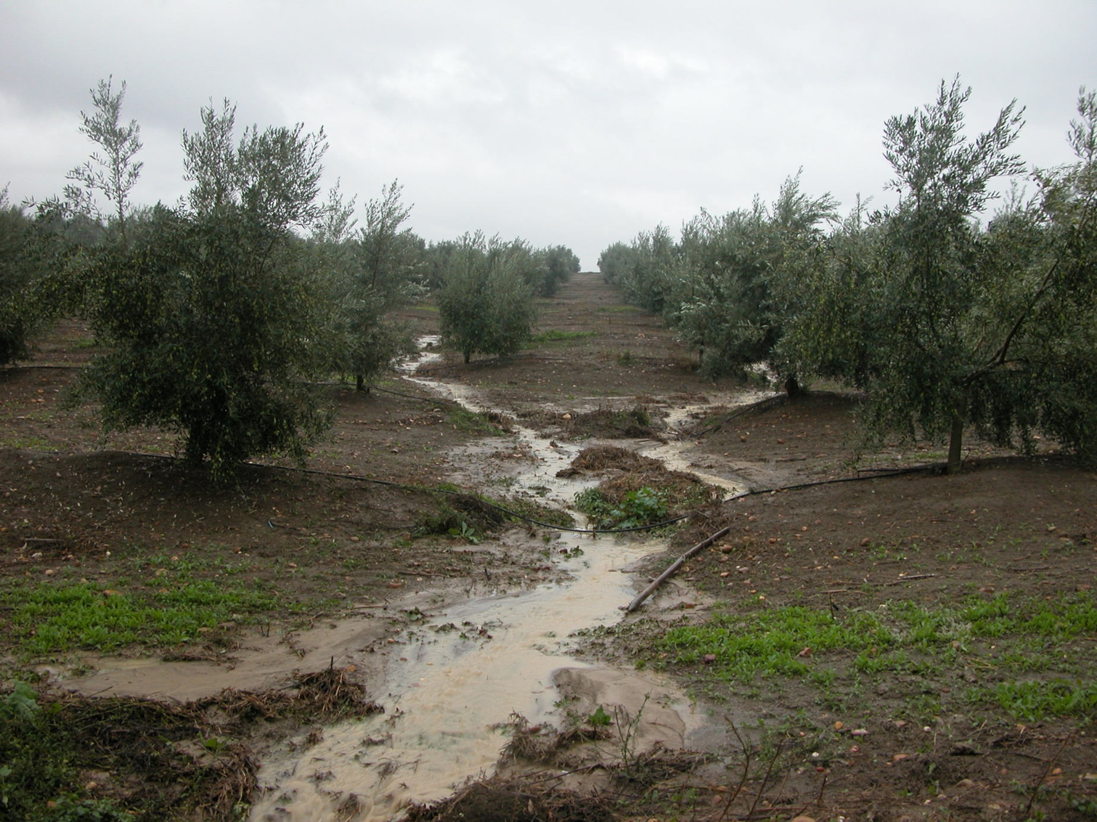
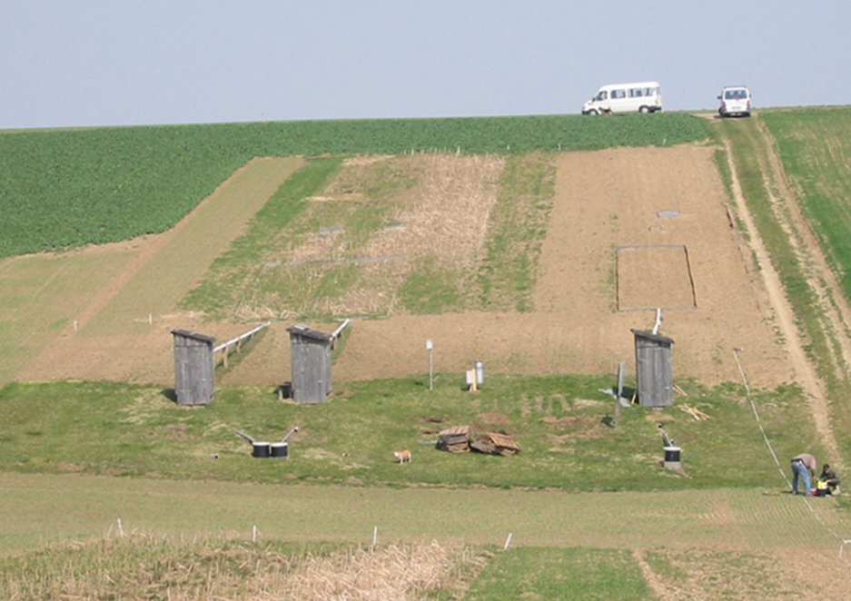
WP1:
A data resource of best management practices
Objectives
Develop an open-data platform for sharing agricultural experiment data.
Provide quality checked experiment data to calibrate / validate models.
Validate experimentally best management practices.
China
Available data
5 countries, 12 sites, 27 treatments, 160 data files
Cropland, orchards, vineyards from rainfed & irrigated systems
Field plot & catchment scale data
Climate, Soil properties, Management, Runoff & Soil loss, Nutrients, Crop yields, Irrigation volume data
Outcomes
Capturing the value of long-term experiments to allow cross-scale modelling of soil management outcomes
China
Spain
Austria

Slide 3
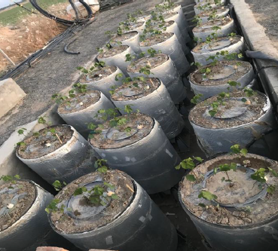
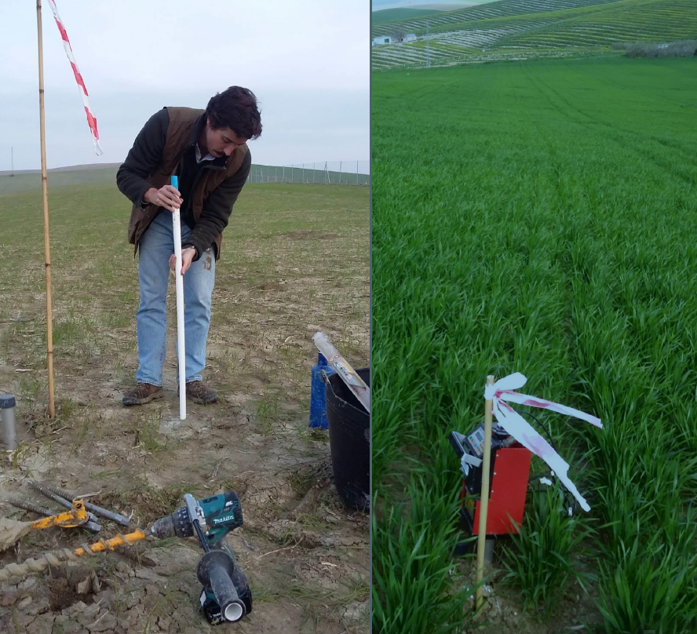
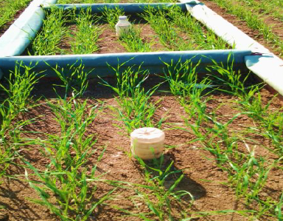
WP2.1:
Crop simulation modelling
Objectives
Calibrate and validate the AquaCrop model with data from long-term experiments of WP1.
Develop specific elements within AquaCrop to simulate cropping under water scarce conditions.
Develop a hybrid-type model to simulate yield responses of tree crops to variable water supply.
Using a GIS platform, integrate crop yield scenarios within catchment analysis.
Outcomes
Calibrate AquaCrop for target crops in SHui enviroments.
Improve salinity module to simulate water stress effects in AquaCrop.
A new water productivity model for tree crops
Insert improved algorithms based on soil hydrology in AquaCrop to upscale the model.
Spain
China
China

Slide 4
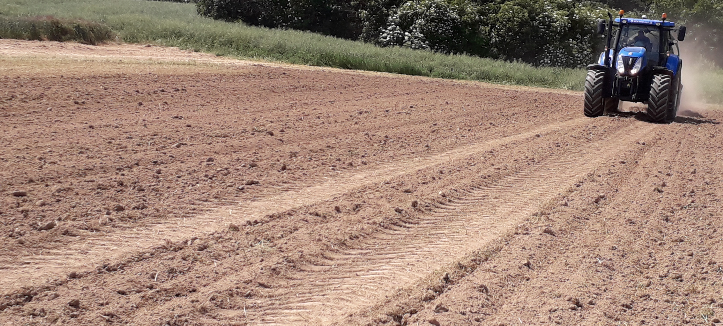
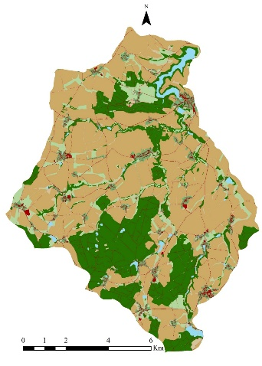
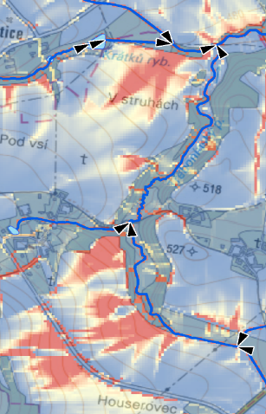
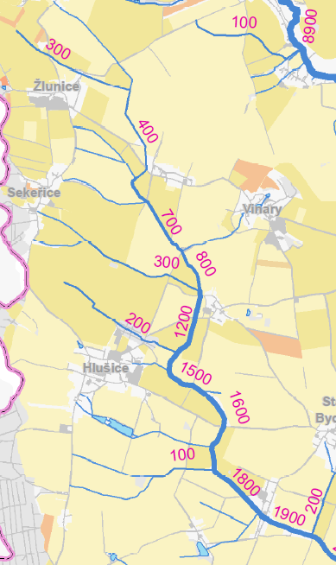
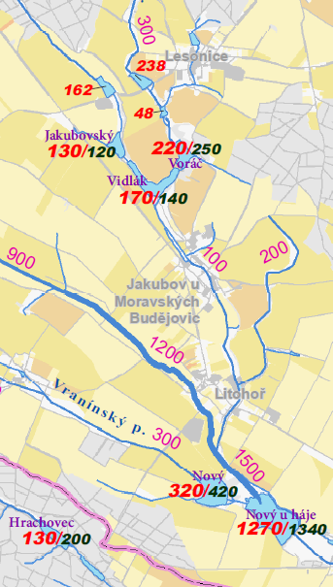
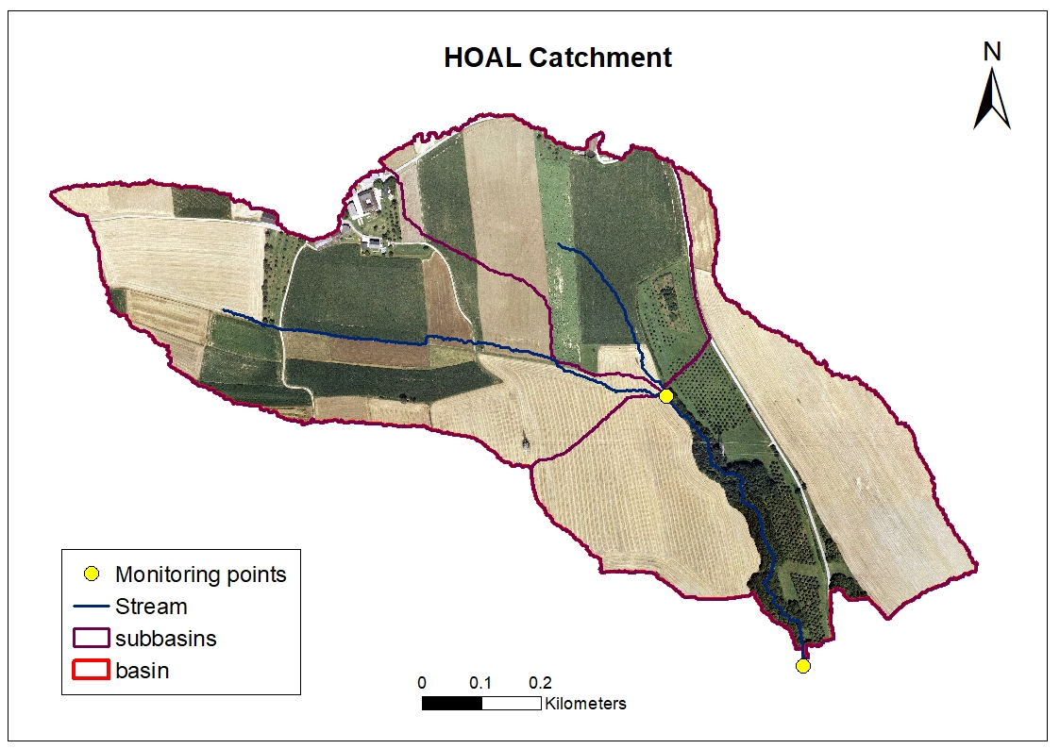
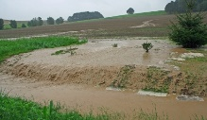
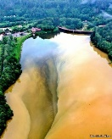
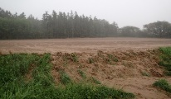
WP2.2:
Hydrology and Soil Erosion Modelling
Objectives
To calibrate hydrological models at different scales
To couple hydrological and crop yield models
To model land-use & management changes on hydrological regime of agricultural landscapes
Cross-test and implement in EU and China
Methods
7 hydrological/soil erosion models; 8 experimental catchments from 50 ha to 8500 km2 over EU and China
3 spatial scales – point/plot – small catchment – large catchment
6 participating institutions = 12 PhD students and post-docs over EU and China
Field plot & catchment scale data
Outcomes
To develop reliable mathematical models to describe water cycle in agricultural catchments
To improve hydrological part of generally used crop/hydrological model AquaCrop
To model different agricultural management techniques to avoid water scarcity or mitigate water shortage, allowing sustainable agriculture under different climatic and economic conditions

Slide 5
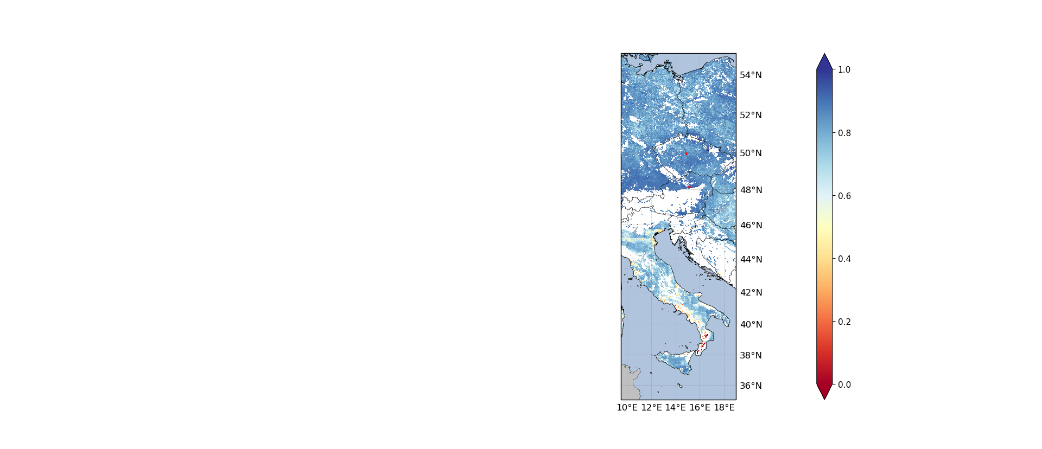
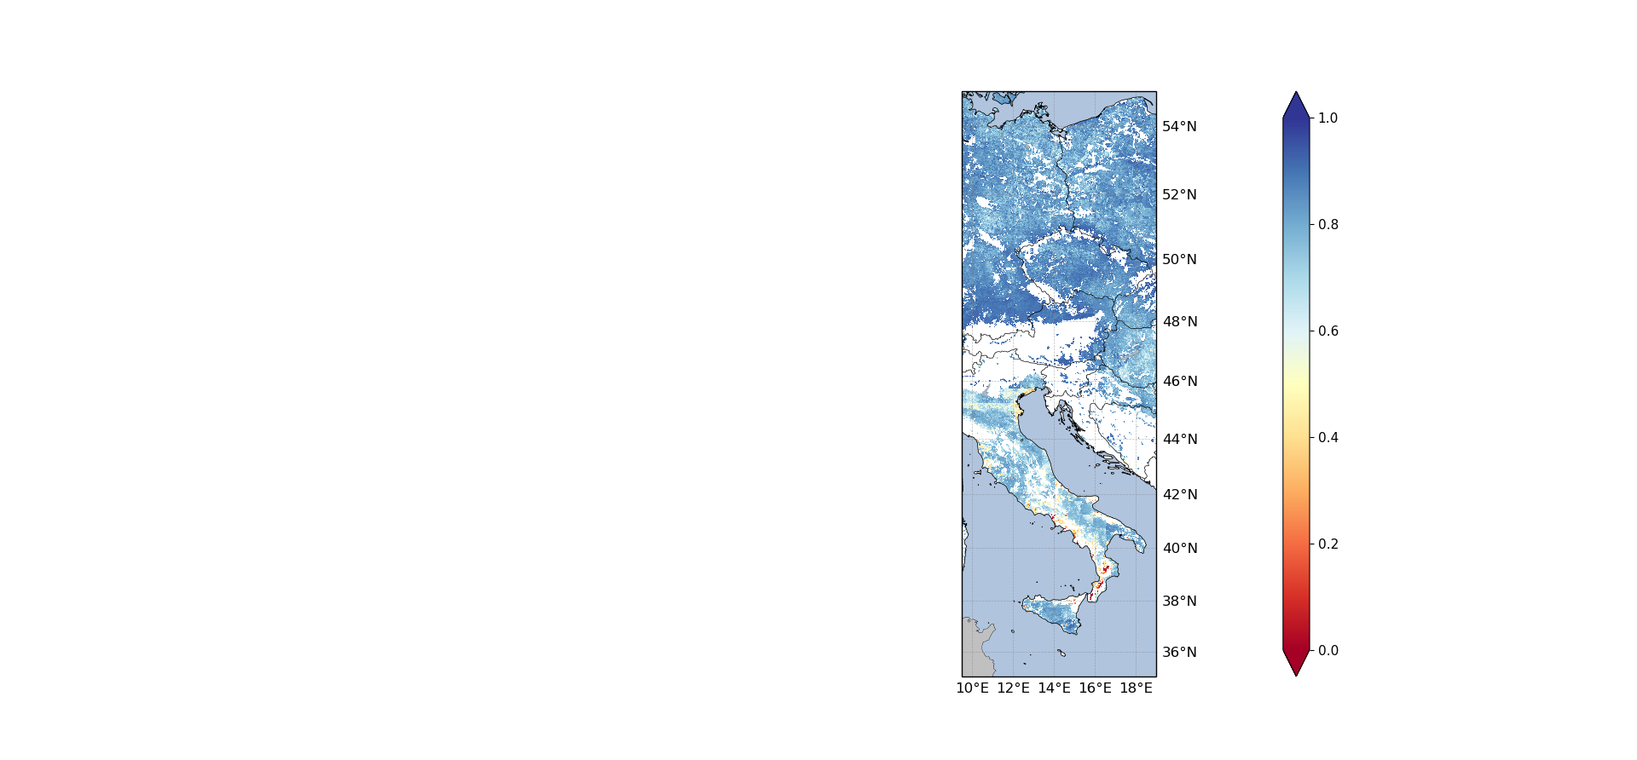
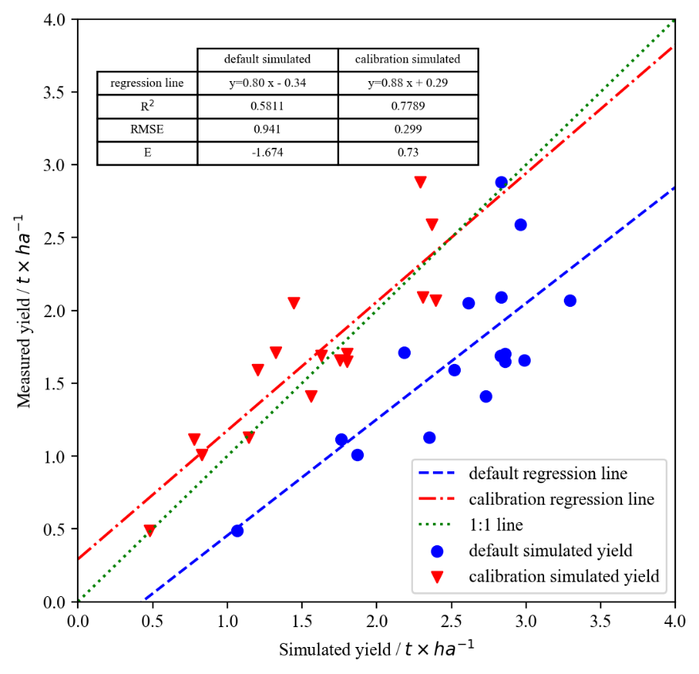
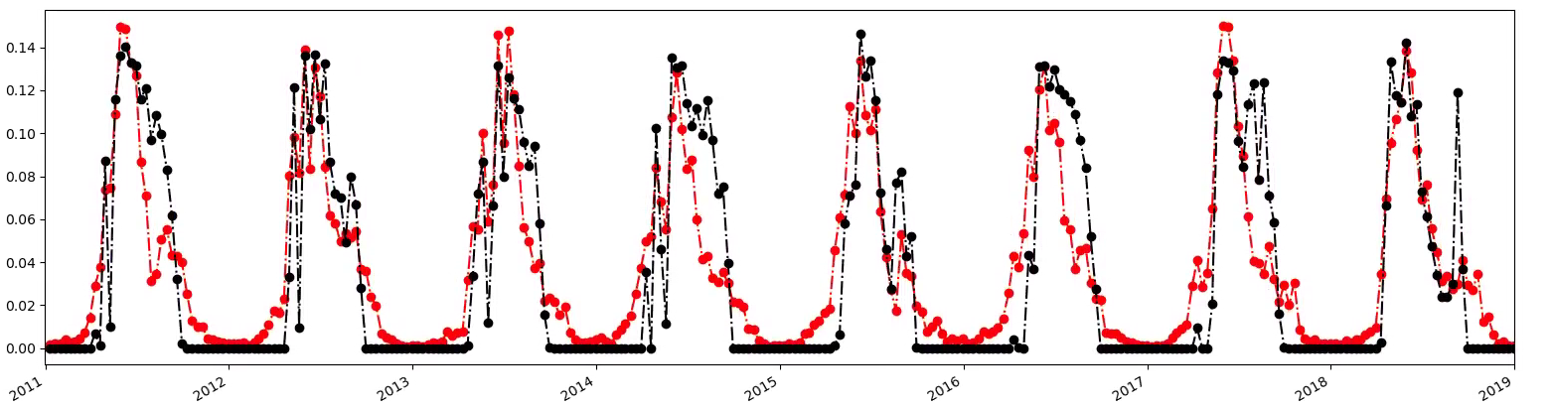


WP3:
Satellite-based data assimilation for integrated
soil & water management
Develop and evaluate regional Aquacrop model at 1 km resolution over Europe & Calibrate Aquacrop model in selected fields in China
Develop backscatter model and apply satellite data assimilation into regional and field-scale crop model
Apply Aquacrop for climate scenarios to optimize crop production
Biomass & soil moisture simulations vs remote sensing & in situ data
Sensitivity analysis and simulations vs in situ data
Biomass
Biomass
I. Nučice, Czech Republic
I
I
II
T. ha ⁻¹. day ⁻¹
R
Soybean,
dryland China
I = Nučice , II= HOAL

Slide 6
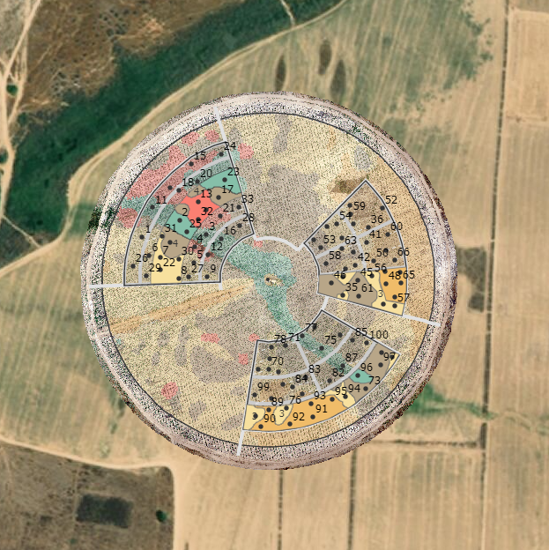
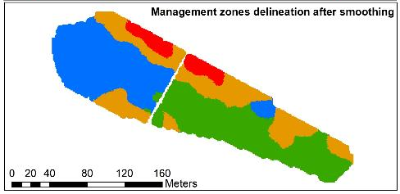
WP4:
Decision Support Systems
for agricultural soil & water management
Objectives
Integrate data & knowledge to interpret data/model outputs from other WPs, by linking temporal and spatial data to farm and region decision making
To build decision support algorithms based on crop-specific objective functions, socio-economic goals, environmental parameters and accessible data.
To convert these algorithms into practical decision support tools
for end-users to optimize crop water management
Available data
Field crop (cotton-maize rotation) with a variable rate irrigation (VRI) center pivot
Commercial vineyard
Commercial peach orchard
Spatial sampling output
Developing models to produce best management maps
Multivariate spatial-statistical analysis with advanced machine learning
methods to cope with spatial distribution of field variables
& complex non-linear correlations between variables:
Model to design a multivariate-spatial stratified-systematic sampling scheme.
Decision Support Model to delineate management zones.
Two predictive models:
Stem water potential (SWP) & Crop Water Stress index (CWSI).
6

Slide 7
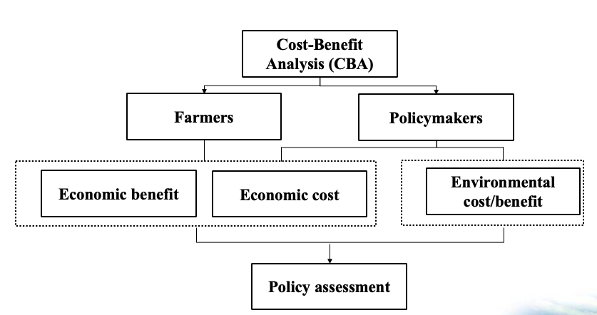
WP5:
Socio-economic & environmental implications for policy planning
Objectives
Adapted Cost-Benefit analysis of best management on-farm strategies
Efficient strategic framework for water resources allocation & soil management
Assess environmental performance of the best management practices
Coordinate and disseminate economic analysis for stakeholders
Available data
Supplied by National Bureau of Statistics of China, Eurostat, FAO and
National statistics databases from partner countries
Outcomes
Identify economically, socially & ecologically feasible possible solutions for farmers / catchment managers

